Slide 1
Distance Vector Routing Protocols
Routing Protocols and Concepts – Chapter 4

Slide 2
Objectives
Identify the characteristics of distance vector routing protocols.
Describe the network discovery process of distance vector routing protocols using Routing Information Protocol (RIP).
Describe the processes to maintain accurate routing tables used by distance vector routing protocols.
Identify the conditions leading to a routing loop and explain the implications for router performance.
Recognize that distance vector routing protocols are in use today.

Slide 3
Distance Vector Routing Protocols
Examples of Distance Vector routing protocols:
  Routing Information Protocol (RIP)
  Interior Gateway Routing Protocol (IGRP)
  Enhanced Interior Gateway Routing Protocol (EIGRP)

Slide 4
Distance Vector Routing Protocols
Distance Vector Technology - the Meaning of Distance Vector
  A router using distance vector routing protocols knows 2 things:
    Distance to final destination
    Vector, or direction, traffic should be directed

Slide 5
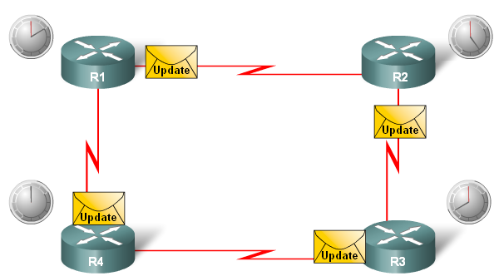
Distance Vector Routing Protocols
Characteristics of Distance Vector routing protocols:
  Periodic updates
  Neighbors
  Broadcast updates
  Entire routing table is included with routing update

Slide 6
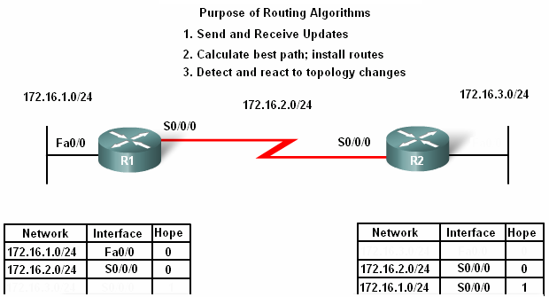
Distance Vector Routing Protocols
Routing Protocol Algorithm:
  Defined as a procedure for accomplishing a certain task

Slide 7
Distance Vector Routing Protocols
Routing Protocol Characteristics
  Criteria used to compare routing protocols includes
    Time to convergence
    Scalability
    Resource usage
    Implementation & maintenance

Slide 8
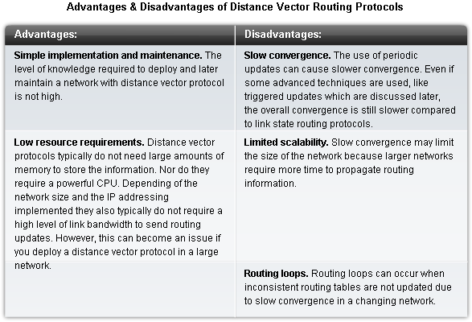
Distance Vector Routing Protocols

Slide 9
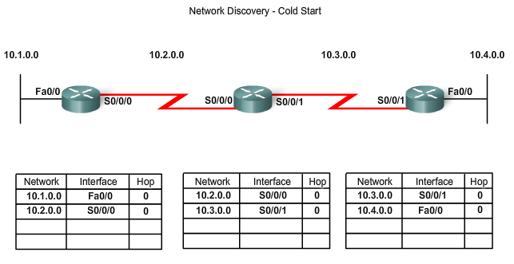
Network Discovery
Router initial start up (Cold Starts)
  Initial network discovery
    Directly connected networks are initially placed in routing table

Slide 10
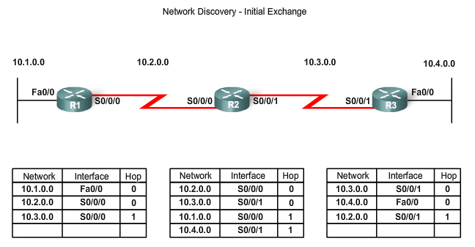
Network Discovery
Initial Exchange of Routing Information
  If a routing protocol is configured then:
    Routers will exchange routing information
    Routing updates received from other routers
Router checks update for new information
  If there is new information:
    Metric is updated
    New information is stored in routing table

Slide 11
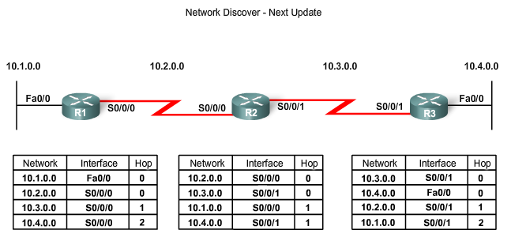
Network Discovery
Exchange of Routing Information
  Router convergence is reached when
    All routing tables in the network contain the same network information
  Routers continue to exchange routing information
    If no new information is found then Convergence is reached

Slide 12
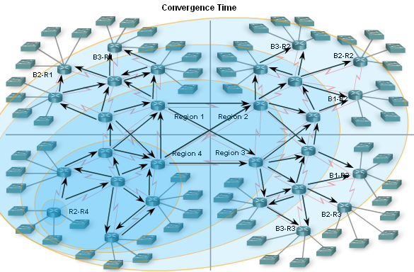
Network Discovery
Convergence must be reached before a network is considered completely operable
Speed of achieving convergence consists of 2 interdependent categories
  Speed of broadcasting routing information
  Speed of calculating routes

Slide 13
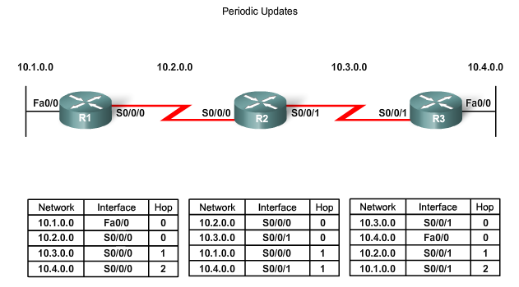
Routing Table Maintenance
Periodic Updates: RIPv1 & RIPv2
  These are time intervals in which a router sends out its entire routing table

Slide 14
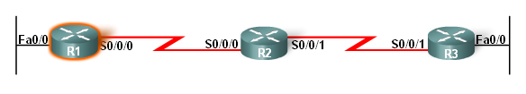
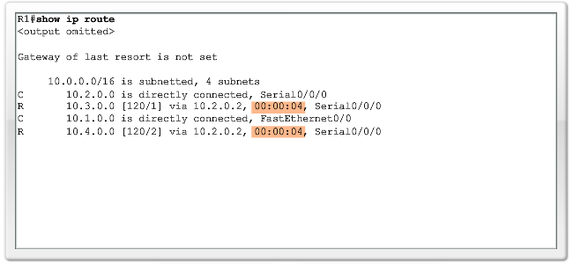
Routing Table Maintenance
RIP uses 4 timers
  Update timer
  Invalid timer
  Holddown timer
  Flush timer

Slide 15
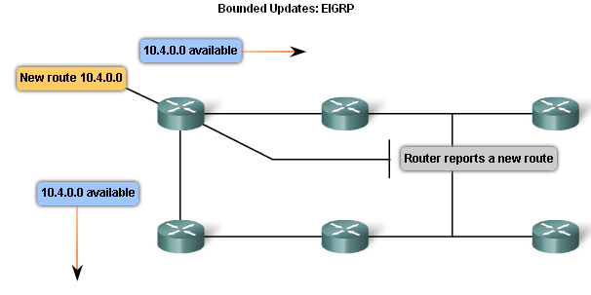
Routing Table Maintenance
Bounded Updates: EIGRP
EIRPG routing updates are:
  Partial updates
  Triggered by topology changes
  Bounded
  Non periodic

Slide 16
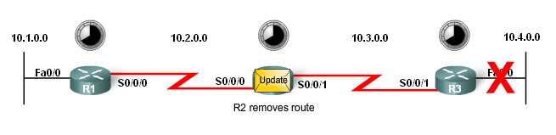
Routing Table Maintenance
Triggered Updates
  Conditions in which triggered updates are sent
  Interface changes state
  Route becomes unreachable
  Route is placed in routing table

Slide 17
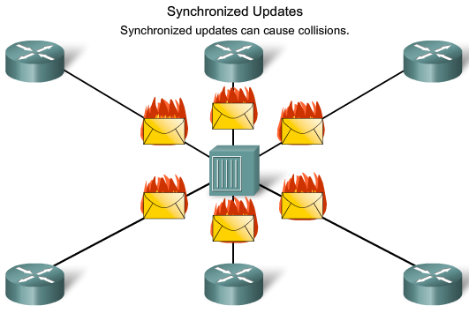
Routing Table Maintenance
Random Jitter
  Synchronized updates - a condition where multiple routers on multi access LAN segments transmit routing updates at the same time.
    Problems with synchronized updates
      Bandwidth consumption
      Packet collisions
    Solution to problems with synchronized updates
      Use of random variable called RIP_JITTER

Slide 18
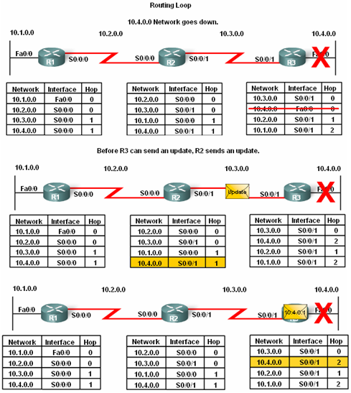
Routing Loops
Routing loops are
  A condition in which a packet is continuously transmitted within a series of routers without ever reaching its destination.

Slide 19
Routing Loops
Routing loops may be caused by:
  Incorrectly configured static routes
  Incorrectly configured route redistribution
  Slow convergence
  Incorrectly configured discard routes
Routing loops can create the following issues:
  Excess use of bandwidth
  CPU resources may be strained
  Network convergence is degraded
  Routing updates may be lost or not processed in a timely manner

Slide 20
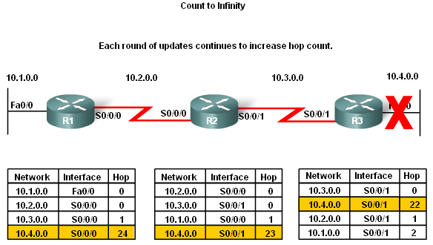
Routing Loops
Count to Infinity
  This is a routing loop whereby packets bounce infinitely around a network

Slide 21
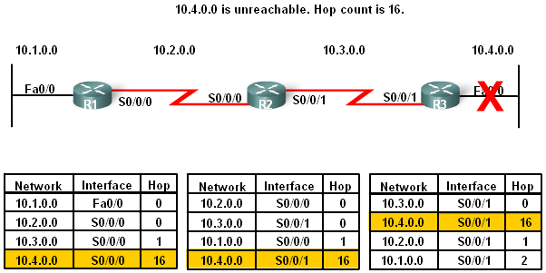
Routing Loops
Setting a maximum
Distance Vector routing protocols set a specified metric value to indicate infinity
  Once a router “counts to infinity” it marks the route as unreachable

Slide 22
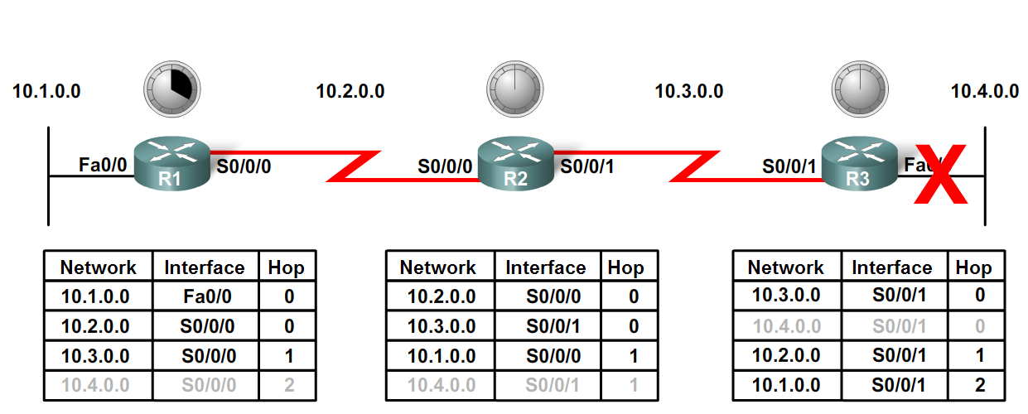
Routing Loops
Preventing loops with holddown timers
  Holddown timers allow a router to not accept any changes to a route for a specified period of time
  Point of using holddown timers
    Allows routing updates to propagate through network with the most current information

Slide 23
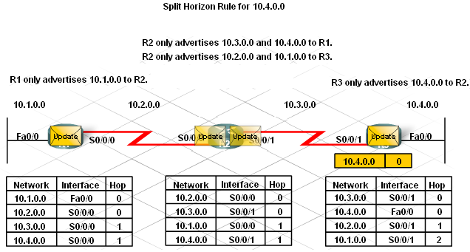
Routing Loops
The Split Horizon Rule is used to prevent routing loops
Split Horizon rule:
  A router should not advertise a network through the interface from which the update came

Slide 24
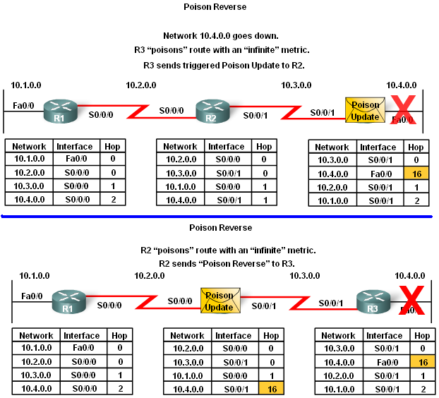
Routing Loops
Split horizon with poison reverse
  The rule states that once a router learns of an unreachable route through an interface, advertise it as unreachable back through the same interface

Slide 25
Routing Loops
IP & TTL
  Purpose of the TTL field
    The TTL field is found in an IP header and is used to prevent packets from endlessly traveling on a network
How the TTL field works
  TTL field contains a numeric value
    The numeric value is decreased by one by every router on the route to the destination
    If numeric value reaches 0 then Packet is discarded

Slide 26
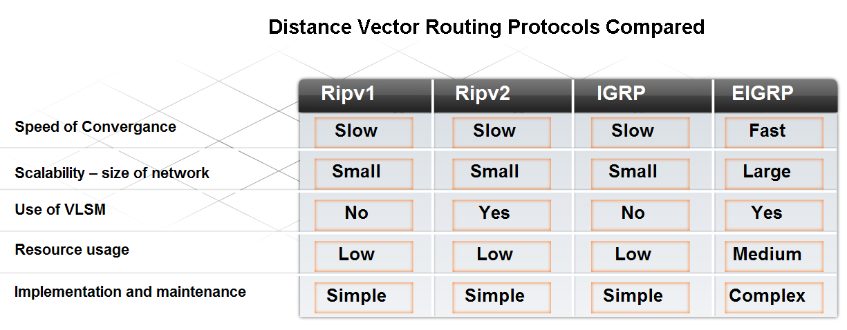
Routing Protocols Today
Factors used to determine whether to use RIP or EIGRP include
  Network size
  Compatibility between models of routers
  Administrative knowledge

Slide 27
Routing Protocols Today
RIP
  Features of RIP:
    Supports split horizon & split horizon with poison reverse
    Capable of load balancing
    Easy to configure
    Works in a multi vendor router environment

Slide 28
Routing Protocols Today
EIGRP
  Features of EIGRP:
    Triggered updates
    EIGRP hello protocol used to establish neighbor adjacencies
    Supports VLSM & route summarization
    Use of topology table to maintain all routes
    Classless distance vector routing protocol
    Cisco proprietary protocol

Slide 29
Summary
Characteristics of Distance Vector routing protocols
  Periodic updates
  RIP routing updates include the entire routing table
  Neighbors are defined as routers that share a link and are configured to use the same protocol
The network discovery process for D.V. routing protocol
  Directly connected routes are placed in routing table 1st
  If a routing protocol is configured then
    Routers will exchange routing information
  Convergence is reached when all network routers have the
  same network information

Slide 30
Summary
D.V. routing protocols maintains routing tables by
  RIP sending out periodic updates
  RIP using 4 different timers to ensure information is accurate and convergence is achieved in a timely manner
  EIGRP sending out triggered updates
D.V. routing protocols may be prone to routing loops
  routing loops are a condition in which packets continuously traverse a network
  Mechanisms used to minimize routing loops include defining maximum hop count, holddown timers, split horizon, route poisoning and triggered updates

Slide 31
Summary
Conditions that can lead to routing loops include
  Incorrectly configured static routes
  Incorrectly configured route redistribution
  Slow convergence
  Incorrectly configured discard routes
How routing loops can impact network performance includes:
  Excess use of bandwidth
  CPU resources may be strained
  Network convergence is degraded
  Routing updates may be lost or not processed

Slide 32
Summary
Routing Information Protocol (RIP)
  A distance vector protocol that has 2 versions
    RIPv1 - a classful routing protocol
    RIPv2 - a classless routing protocol
Enhanced Interior Gateway Routing Protocol (EIGRP)
  A distance vector routing protocols that has some features of link state routing protocols
  A Cisco proprietary routing protocol

